Slide 1
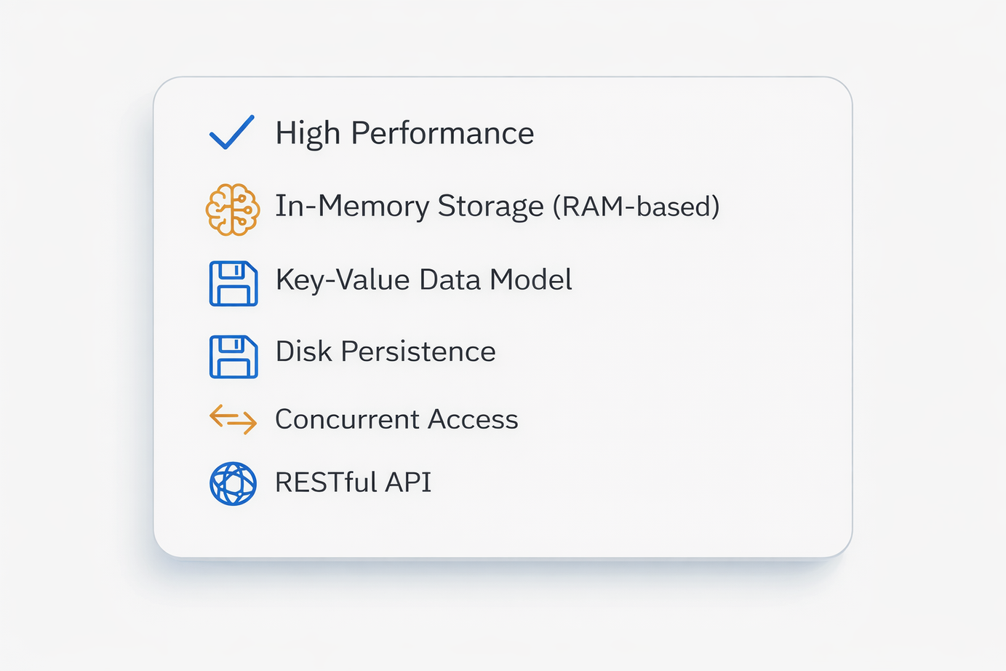
PyKV : A Scalable Key-Value Store
with Persistence
PyKV : Python-based Key-Value Store
PyKV is a high-performance, in-memory key-value store designed to solve the core challenges of modern data systems – low latency access, data durability, fault tolerance and concurrent request handling
The system follows a modular architecture, enabling independent design, testing, and benchmarking of key components like caching, persistence, replication and concurrency control.
Internal Data Structure Used:
~ Presented by Rupali Shewale

Slide 2
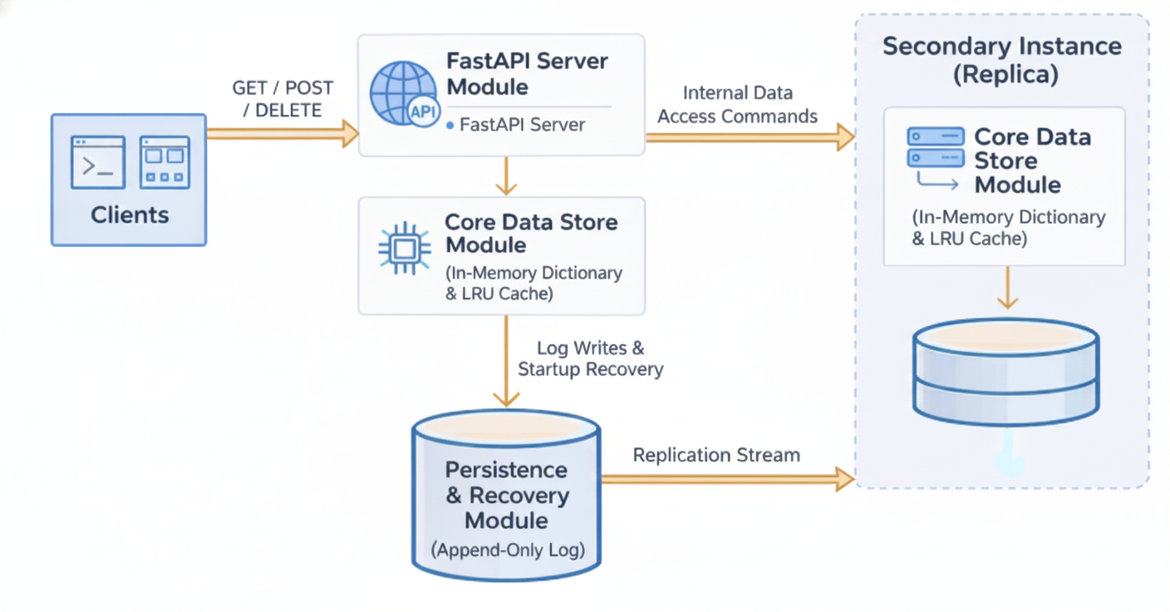
System Architecture

Slide 3
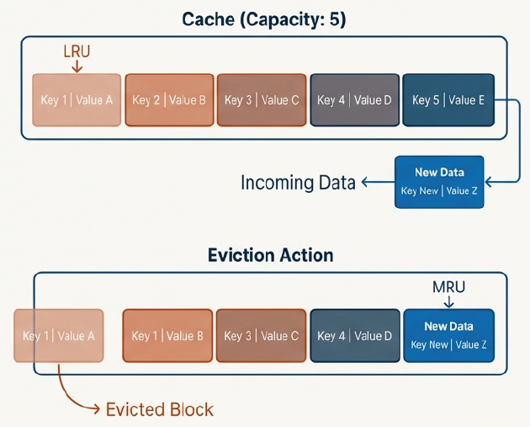
Module 1
The Core Data Store
Core Purpose: To hold all key-value pairs in memory for O(1) access and enforce a strict memory usage policy via an LRU eviction
The LRU Cache stores key-value pairs
Every key access updates its “recent usage” status.
When the cache reaches maximum capacity, the least recently accessed key is removed automatically.
Each Cache entry is represented as a node that can be reordered efficiently
Internal Data Structure Used:
A Combination of a Doubly Linked List and a HashMap (Python Dictionary) ⟶ True O(1) Cache Operations
Doubly Linked List : Maintains usage order of keys
Head = LRU Tail = MRU
Dictionary : Maps Keys to DLL nodes for fast lookup

Slide 4
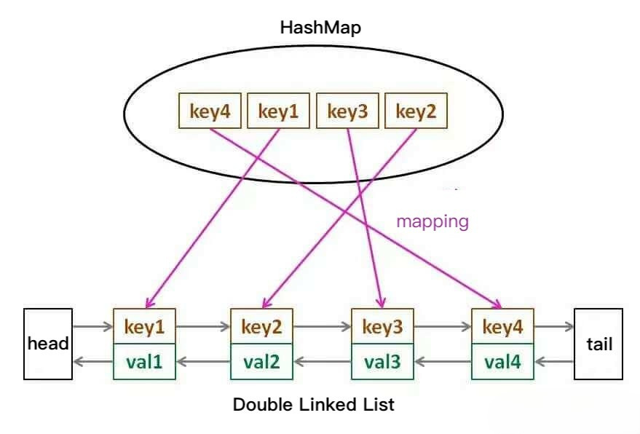
Doubly Linked List
Data Structures
MRU items → tail , LRU items → head
add_to_tail(node) – Adds a new node at tail | Insertion
move_to_tail(node) – Moves an existing node to tail | Access/Update
remove_head() – Removes the node from head | Eviction when full.
HashMap / Dictionary
Stores references to nodes of the DLL for fast access by key.
Insert: Add new key with reference to its DLL node.
Search: Retrieve node from dictionary quickly.
Delete: Remove key when node is evicted from DLL.

Slide 5
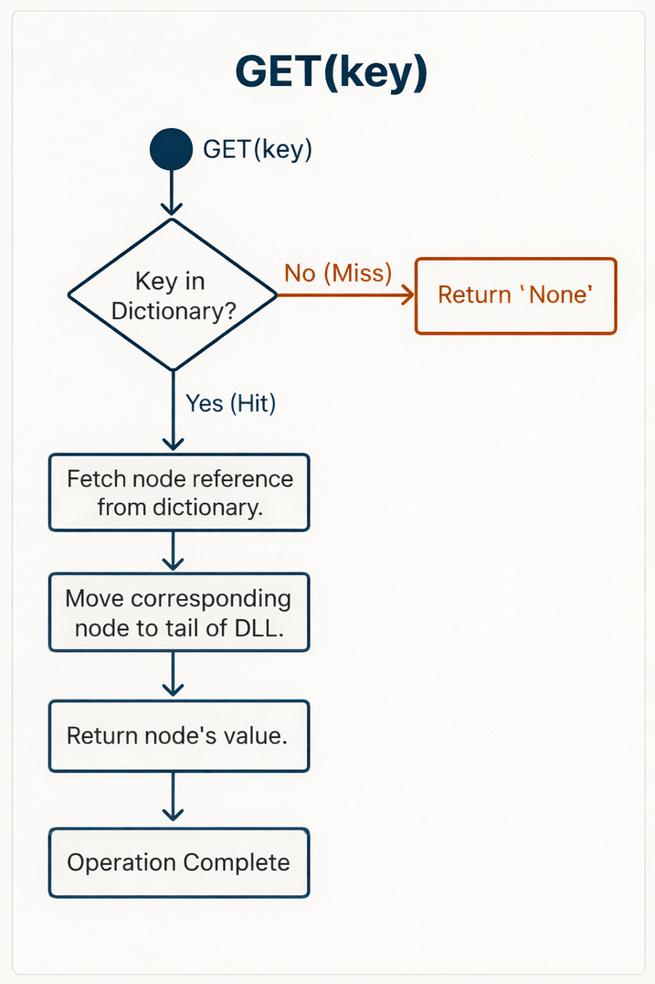
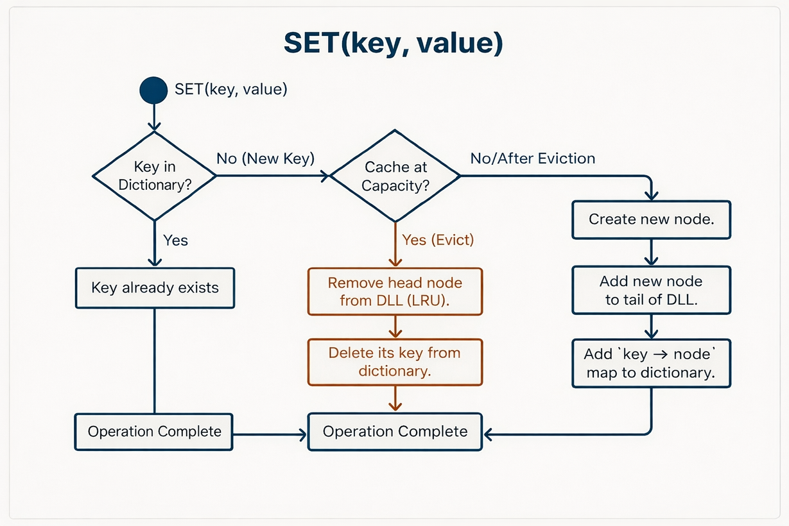
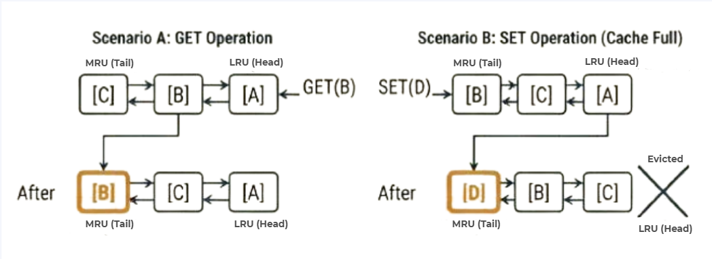

LRU Operation Flow

Slide 6
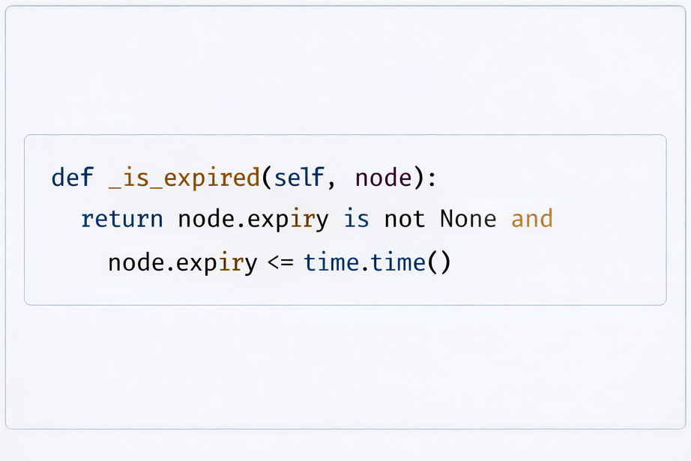
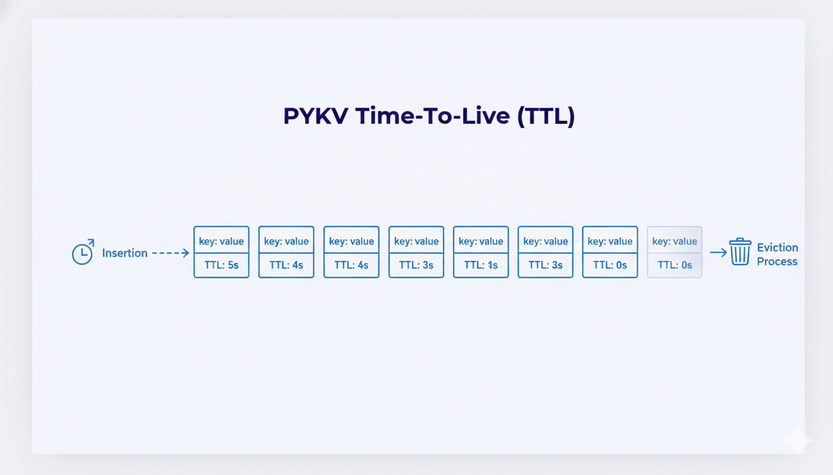
Efficient Memory Management: TTL
Time To Live (TTL)
The Bottleneck: Keys in memory without an expiration can accumulate, wasting memory and reducing efficiency over time.
The Solution: TTL (Time-To-Live) allows keys to automatically expire after a specified duration, freeing memory and keeping the cache efficient without manual intervention.
Each node contains an optional ‘expiry’ timestamp.
An ‘_is_expired()’ check is performed on ‘get’, treating expired keys as a cache miss and removing them.

Slide 7
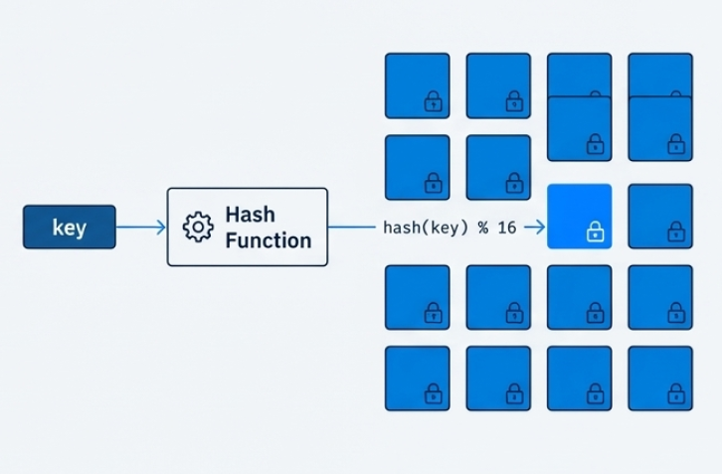
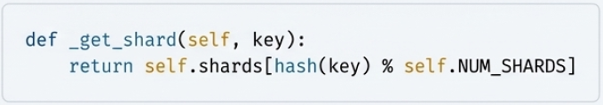
Scaling Concurrency with Sharding
Sharding
The Bottleneck : In a concurrent environment a single lock protecting the entire cache would serialize all operations, nullifying the benefits of multiple threads.
The Solution : Sharding
The ‘CoreStore’ is not one large cahce, but an array of smaller & independent ‘LRUCache’ instances.
How it Works :
The total capacity is divided among ‘NUM_SHARDS’ (ex.16)
A key is deterministically assigned to a shard using a hash function :
Each shard has its own lock, so operations on keys that hash to different shards can execute in parallel without contention

Slide 8
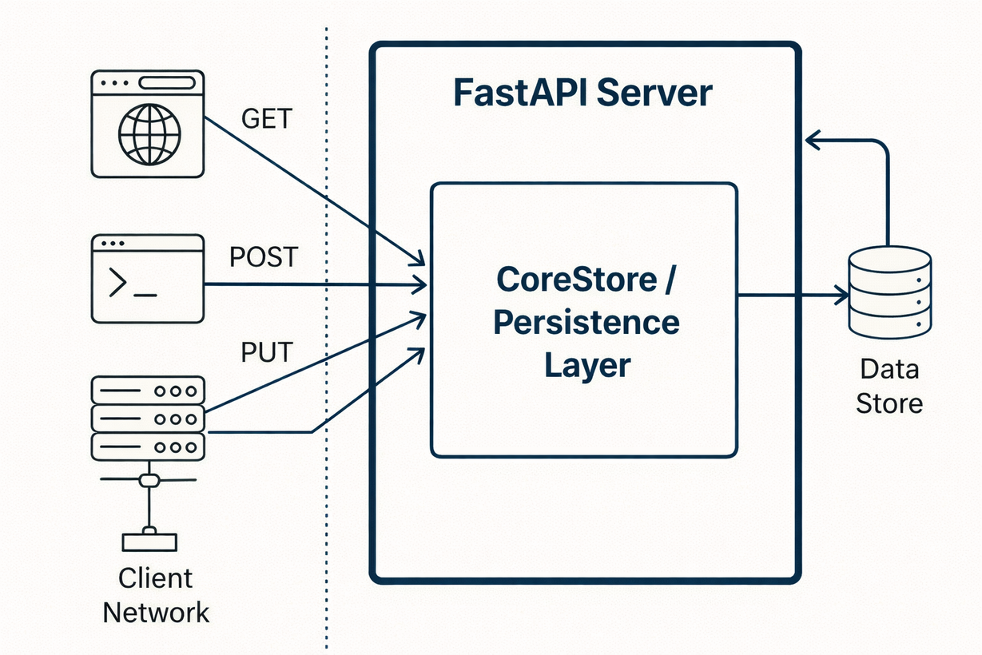
Module 2
FastAPI Server layer
The FastAPI server acts as the primary interaction layer between external clients and the core data sore.
It handles all HTTP request routing, input validation, error handling and response formatting.
All operations are internally routed to the ‘CoreStore’ and ‘Persistence’ layers.
Key Components Used
FastAPI Framework
Async route handlers (‘async’ def)
Pydantic modules for validation
HTTP exceptions for error handling

Slide 9
API Routes & Operations
HTTP Method | Endpoint | Operation
POST | /kv/ | Insert a new key-value pair.
GET | /kv/{key} | Fetch the value for a given key.
PUT | /kv/{key} | Update the value for an existing key.
DELETE | /kv/{key} | Remove a key_value pair.
GET | /kv/ | List all keys (with optional prefix filter).
GET | /kv-items | List all keys with their values and TTL
GET | /stats | Get internal cache statistics (capacity, size, hits, misses, evictions).

Slide 10
Pydantic Models: The Data Validation Layer
Purpose
Prevents invalid or malformed data from reaching the core logic,
Automatically validates incoming request payloads against a defined schema.
Returns clear, machine-readable validation errors to clients.
‘KeyValue’ Model
‘ValueOnly’ Model
Used for insert Operations
Used for update Operations
# Ensures both key and value
# are provided as strings
class KeyValue(BaseModel):
key: str
value: str
ttl : int | None = None
# Restricts input to only
# the ‘value’ field.
class ValueOnly(BaseModel):
value: str
ttl : int | None = None

Slide 11
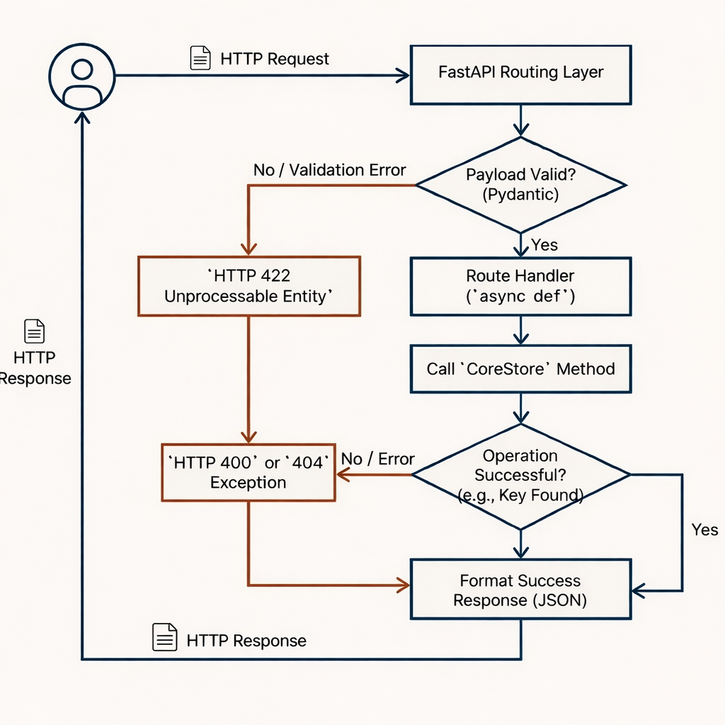

Slide 12
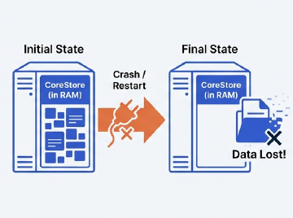
Module
3 - A
Persistence & Recovery
Internal Data Structure Used:
PyKV is designed as a high-performance, in-memory key-value store. This offers incredible speed, but presents a critical risk:
All data resides in RAM
A server crash, restart, or power loss means complete data loss
The Question : How can we achieve the performance of an in-memory system while guaranteeing that data is never lost?
To ensure durability, PyKV implements a persistence layer that acts as a safety net for the in-memory CoreStore.
It Operates on a simple but powerful principle :
Record every change to disk

Slide 13
Append-Only Log
Every Operation that modifies data is first written to a log on disk before being confirmed.
This ‘append-only’ approach is the cornerstone of PyKV’s durability.
Key Guarantee:
By persisting the **intent** to change data before a system failure can couur, we guarantee durability
Structure: each entry in the Write-Ahead log is a structured, self-contained record of a single operation.
Format : We use JSON for its simplicity, human-readability, and broad language support.
{"time": "2023-10-27T10:00:01Z", "op": "SET",
"key": "user:123", "value": "Alice" , “ttl”: “100”}
{"time": "2023-10-27T10:00:05Z", "op": "UPDATE",
"key": "user:123", "value": "Alicia", “ttl”: None}
{"time": "2023-10-27T10:00:12Z", "op": "DELETE",
"key": "user:123", "value": null}

Slide 14
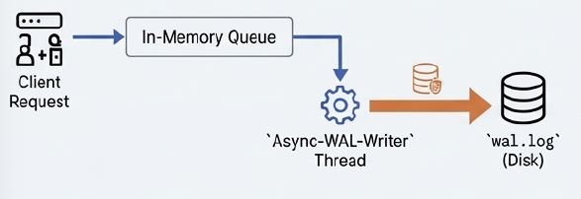
Performance Optimization: Asynchronous WAL Writer
The Problem
Writing every operation directly to disk is slow.
If disk I/O runs in the main server thread, client requests get blocked, increasing latency.
The Solution
To prevent disk I/O from blocking client requests, write operations 1st added to a in-memory queue.
A dedicated background thread works continuously to flush this queue to the wal.log file in batches.
This decouples client latency from disk latency
How It Works (Flow)
Client sends a write request (SET / UPDATE / DELETE)
Operation is added to an in-memory WAL queue
Client response is returned immediately (non-blocking)
A background WAL writer thread:
Picks multiple entries (batch)
Writes them to wal.log
Calls fsync() to ensure durability
If disk write fails, WAL entries remain in memory and are retried safely.
On shutdown, remaining WAL entries are flushed

Slide 15
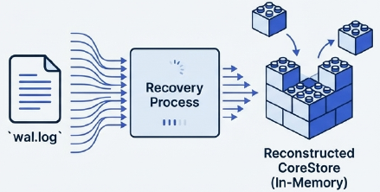
Recovery Process: Rebuilding State on Startup
The Process: Recovery is an automatic process triggered when the PyKV server starts. It uses the Write-Ahead Log as a script to reconstruct the exact state of the ‘CoreStore’ before last shutdown.
How it works (‘recover’ function):
The system checks for the existence of the log file (‘wal.log’)
It opens the file and reads it line-by-line, from beginning to end.
Each line (a JSON entry) is parsed.
The operation (‘SET’, ‘UPDATE’, ‘DELETE’) is “replayed” against the fresh, empty ‘CoreStore’.
By the end of the file, the in-memory store is a perfect mirror of its last known state, ensuring zero data loss from shutdowns.

Slide 16
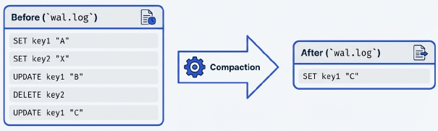
Module
3 - B
Compaction
The Problem:
The append-only nature of the WAL is great for write performance and durability, but it has a long-term consequence : the log file grows independently
Impact:
Log contains redundant data
The server must replay operations for data that no longer exists in final state ⟶ Sower recovery
Solution:
Log Compaction is as optimization process that rewrites the log file, discarding redundant historical data and keeping only latest value for each key.
Goal:
To Produce a new, minimal log file that represents the exact same final in-memory state as the original, but significantly smaller and faster to replay.

Slide 17
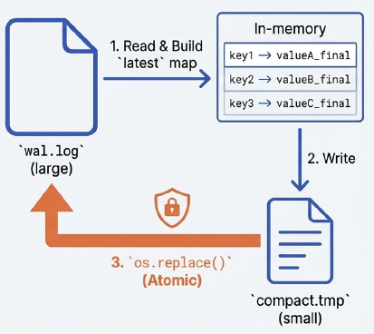
Implementation
The ‘compact_log’ Process:
Acquire Lock: A shared lock prevents new writes to the log while compaction is reading it.
Build Latest State: Read the existing log and populate a dictionary (latest) with the final value for each key.
Write to a Temporary File: Create a new log in a separate temporary file, isolating the write process.
Atomic Replacement: Use `os.replace()` to atomically swap the old log file with the new one. This is a single, uninterruptible OS operation.

Slide 18
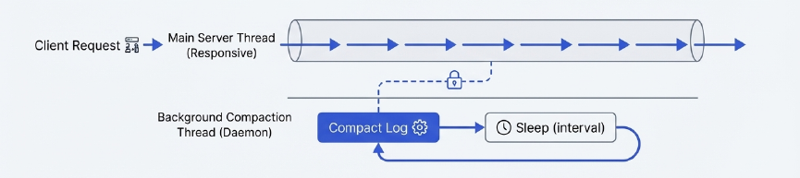
Compaction in the Background
Running a potentially I/O intensive task like compaction in the main server thread would block incoming client requests, harming performance
So PyKV runs the ’compact_log’ function periodically in a separate background thread.
Why This is Effective:
Keeps the main server thread free and responsive to client requests.
Performs essential maintenance transparently to the user.
Uses a shared lock to safely coordinate with the main thread's write operations.

Slide 19
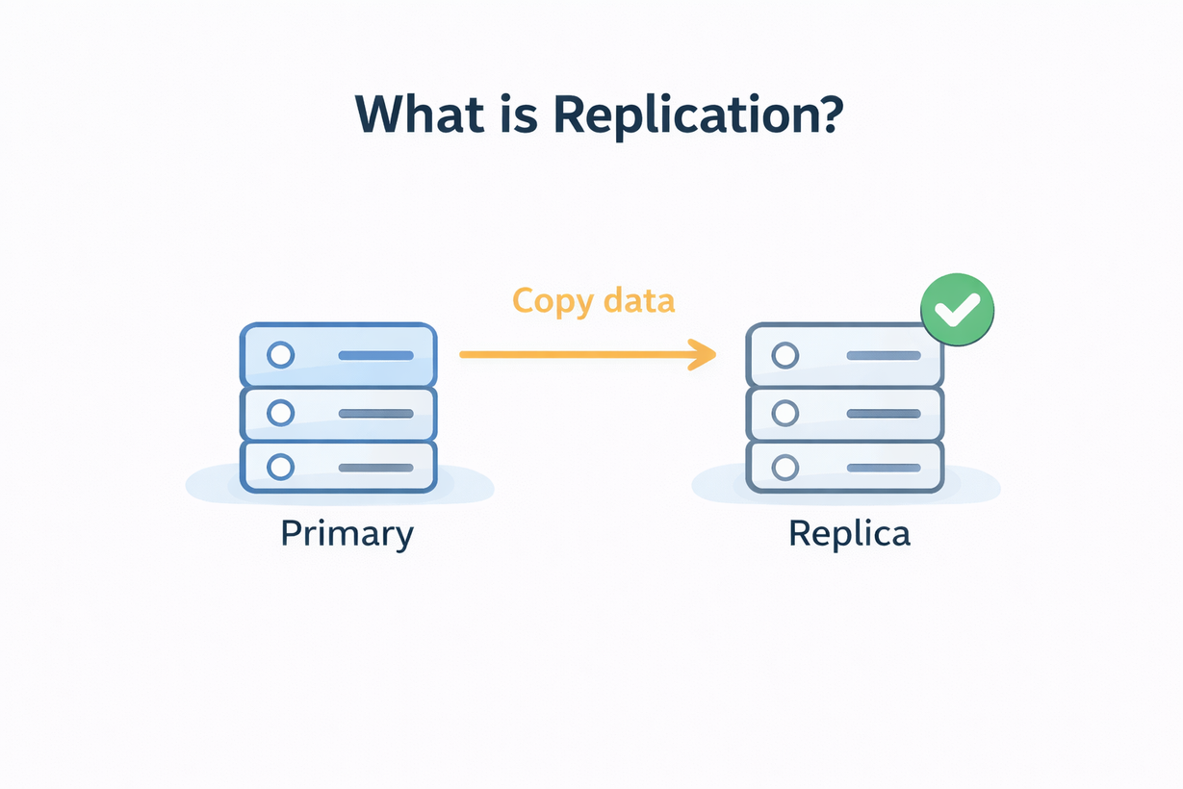
Module 4
Replication
Internal Data Structure Used:
Problem
A single in-memory key-value store is vulnerable to node failure.
If the primary server crashes, all data becomes temporarily unavailable.
Reads and writes cannot be served during downtime.
Purpose:
To provide fault tolerance by maintaining live copies of data on one or more replica servers
Replication in PyKV means maintaining live copies of data on one or more replica servers.
Every write operation performed on the primary node is propagated to replicas.
Replicas act as standby nodes that can serve data if needed.

Slide 20
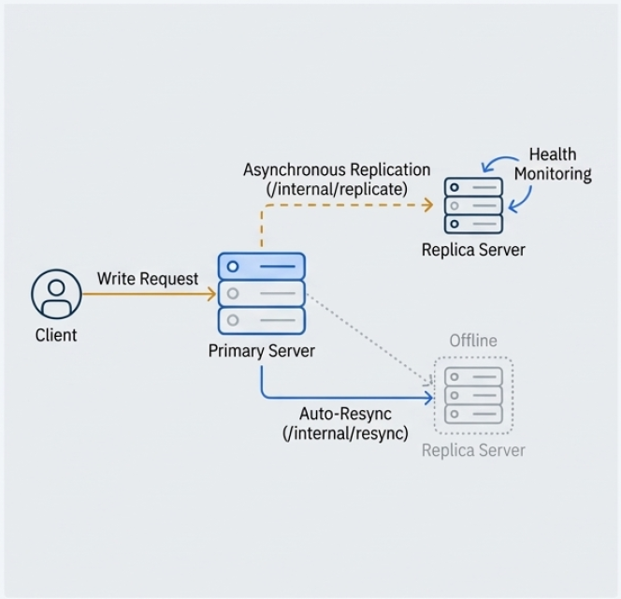
Architectural Design
Primary-Replica Model : A single primary node handles all write requests. The replica nodes maintain copies of the primary’s data
Asynchronous Replication: The primary forwards write operations to all healthy replicas without waiting for response. This prioritizes low write latency.
Health Monitoring: A background process on the primary periodically polls replicas to maintain a list of healthy, active nodes
Auto-Resync on Recovery: When a replica rejoins the cluster after being offline, the primary automatically detects it and initiates a full resync, sending snapshot of its current data

Slide 21
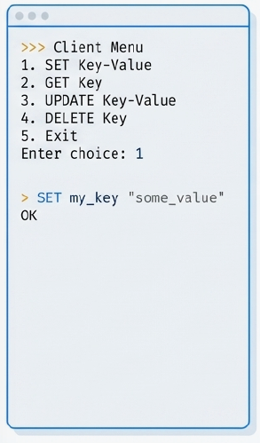
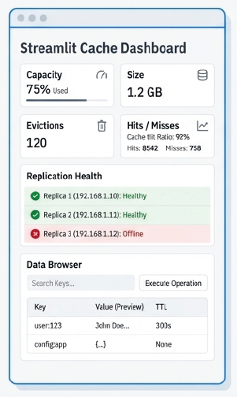
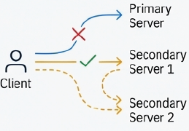
Module 5
Client Interface
Command-Line Interface(CLI)
Graphical-User Interface(GUI)
An interactive menu-driven client for performing operations
Smart Failover : The CLI is configures with a list of server addresses. If a request to the primary fails, it automatically retries the request against next server in the list
Technology: Real-time web dashboard built with Streamlit.
Features
Live Metrics: Auto-refreshing stats for capacity, size, evictions, hits, and hit ratio.
Replication Health: Shows healthy replica status and addresses.
Data Browser: View and verify keys, values, and TTL.
Interactive Ops: Execute operations and measure latency.

Slide 22
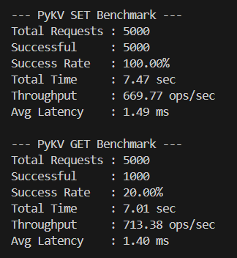
Performance Evaluation (Benchmarking)
Purpose of Benchmarking
To evaluate the performance and efficiency of PyKV under concurrent client load.
To measure response time, throughput, and reliability of key-value operations.
Benchmarking Metrics
Total Time: Overall execution duration
Success Rate: Percentage of successful operations
Throughput: Operations processed per second (ops/sec)
Average Latency: Mean response time per request (ms)
Test Configuration
Concurrent Threads: 20
Total Requests: 5,000
Cache Capacity: 1,000 keys
Operations: SET, GET
~Lower GET success rate is expected due to cache capacity being smaller than total inserted keys.

